Slide 1

GROUP 1

Slide 2

HOTEL MANAGEMENT AND
RESERVATION SYSTEM
Introduction
The purpose of the Hotel Reservation Management System (HRMS) is to assist in the organization and management of critical hotel data, including reservations, payments, client information, and other hotel services. This database system facilitates the integration of various hotel processes, enhancing overall efficiency, accuracy, and data accessibility.

Slide 3
Objectives
Analyse peak and off-peak periods for better room and resource management.
To provide real-time updates on room availability, ensuring that the system can efficiently manage bookings .
Understand customer payment preferences to provide flexible and efficient payment options, enhancing the overall guest experience and simplifying transaction

Slide 4
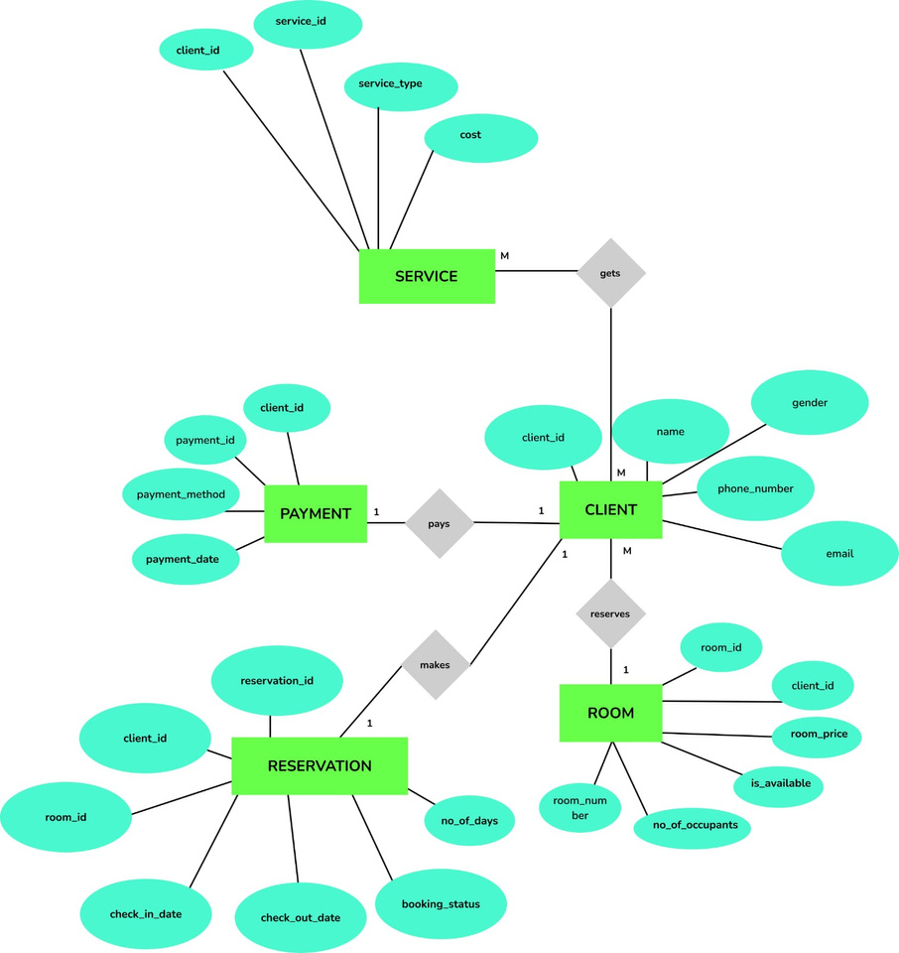

Slide 5
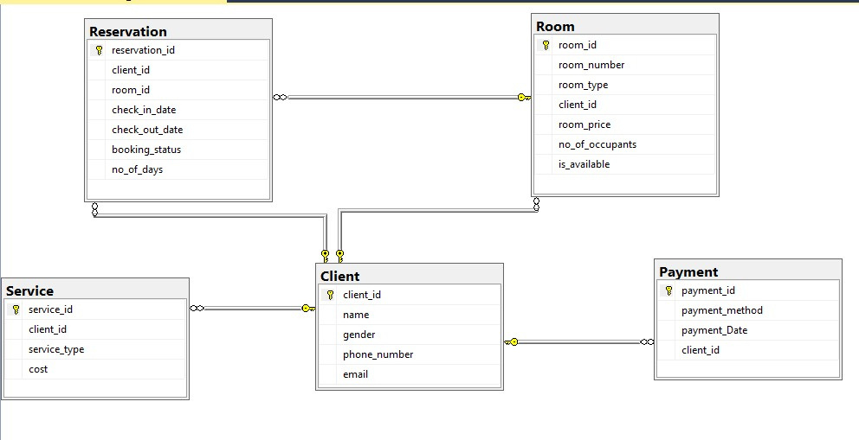
Your paragraph text

Slide 6

Sql queries answering the objectives

Slide 7
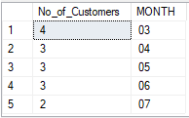
.Predicting Peak and Off-Peak Periods
SELECT COUNT(client_id) AS No_of_Customers, FORMAT(check_in_date, 'MM') AS MONTH
FROM Reservation
GROUP BY FORMAT(check_in_date, 'MM')

Slide 8
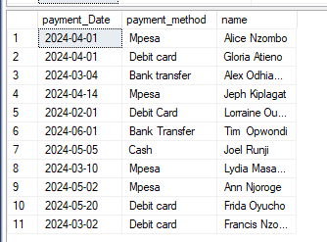
Retrieves Payment Details and Client Name
SELECT P.payment_Date, p.payment_method, C.name
FROM Payment P
INNER JOIN Client C ON C.client_id = P.client_id;

Slide 9
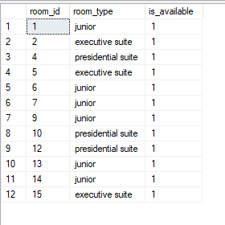
Real-Time Updates on Room Availability.
SELECT room_id, room_type, is_available
FROM Room
WHERE is_available = 1;

Slide 10
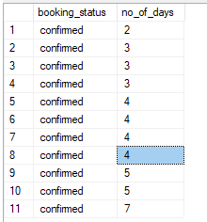
Retrieve booking status and the number of days for confirmed reservations, sorted by the number of days
SELECT booking_status, no_of_days
FROM Reservation
WHERE booking_status='Confirmed'
ORDER BY no_of_days;

Slide 11
Recomendations
Organizations should adopt advanced meeting room analytics tools to gather data on room usage patterns.
Introduce seasonal promotions during off-peak periods to attract more customers.
Simplify transaction workflows for high-demand payment methods to enhance the customer experience.
.

Slide 12

conclusion
Real-time monitoring of room availability ensures that the system can manage bookings efficiently and avoid overbooking
Analysis of check-in trends across different months reveals periods of high and low customer demand. This insight helps identify peak months requiring increased resources and off-peak months for cost optimization.
Data-driven insights into customer behavior, booking patterns, and payment preferences enable the hotel to optimize operations, enhance guest satisfaction, and improve resource management.

Slide 13
Thank you for listening!

